Slide 1
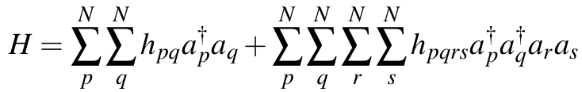

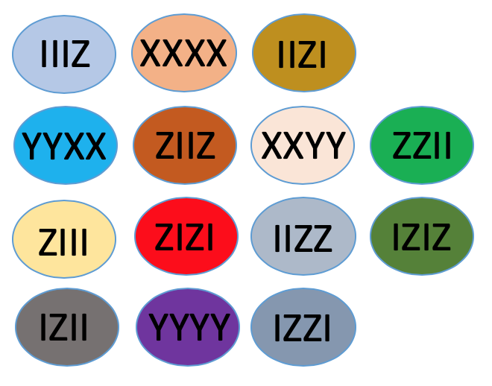
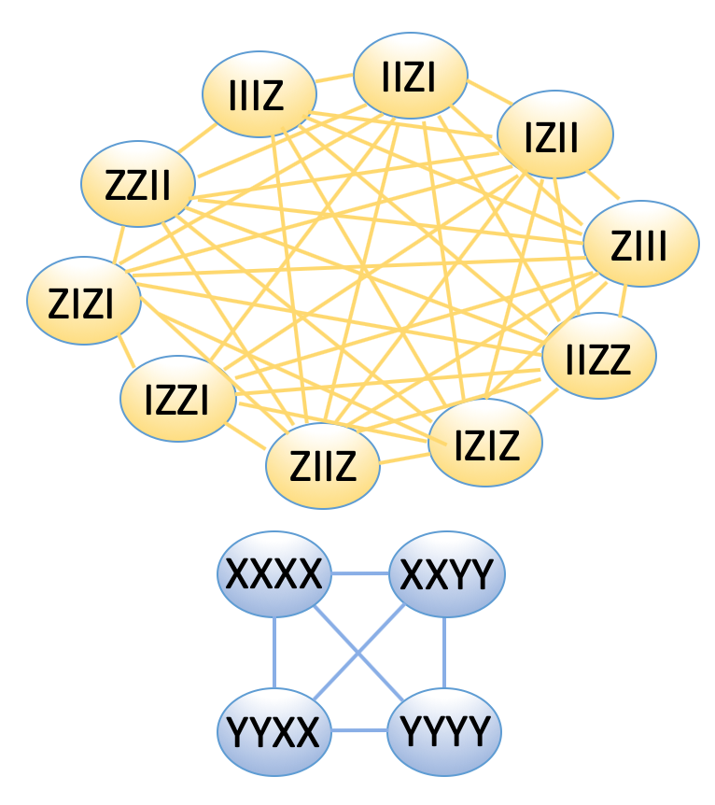
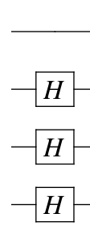
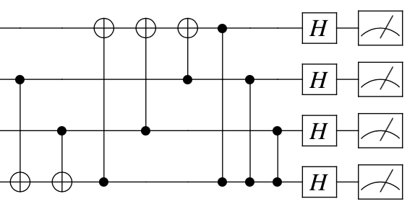
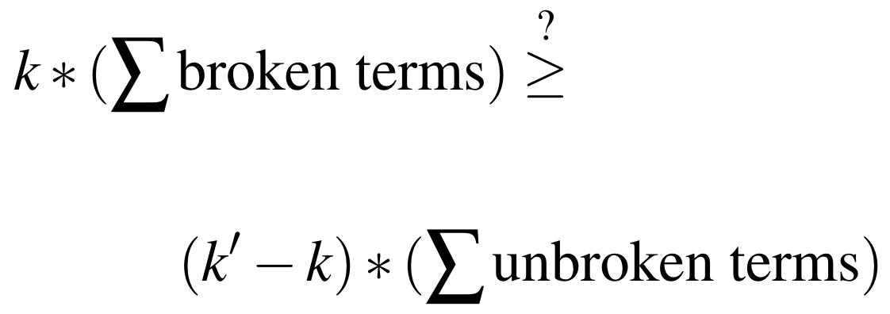
Molecular Hamiltonian
Jordan-Wigner gives Pauli strings
*Naïve Measurement*
*GC Clique Transpilation*
OR
14 subproblems
*Circuit Synthesis*
2 subproblems
*Covariance Mitigation*

Slide 2
IIIZ
IIZI
IZII
ZZII
ZIII
ZIZI
IIZZ
IZZI
ZIIZ
IZIZ
XXXX
XXYY
YYXX
YYYY

Slide 3
XXYY
IIIZ
IIZI
IZII
XXXX
ZZII
ZIII
ZIZI
YYXX
IIZZ
IZZI
YYYY
ZIIZ
IZIZ

Slide 4
IIIZ
XXXX
IIZI
YYXX
ZIIZ
XXYY
ZZII
ZIII
ZIZI
IIZZ
IZIZ
IZII
YYYY
IZZI

